Slide 1
Point Location
AN INTERESTING YET SIMPLE PROBLEM
Prepared by Nilanjan Basu

Slide 2
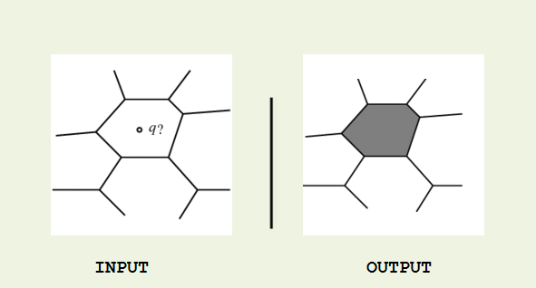
Specification: Point Location Problem
INPUT: A planar subdivision with n edges & a point q.
OUTPUT : A face of the plane containing the point q.
Prepared by Nilanjan Basu

Slide 3
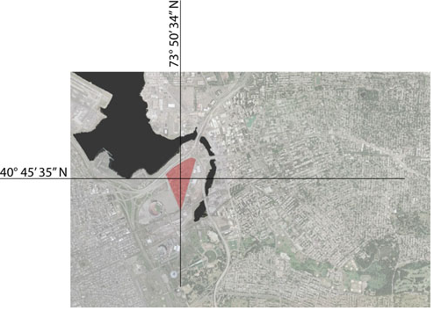
Motivation & Applications
We know the co-ordinates of a crime scene.
We have a map of jurisdiction of the police stations.
Problem: Which station should deploy police force?
Solution: Point Location.
Note: It uses GPS, not used by GPS.
Prepared by Nilanjan Basu

Slide 4
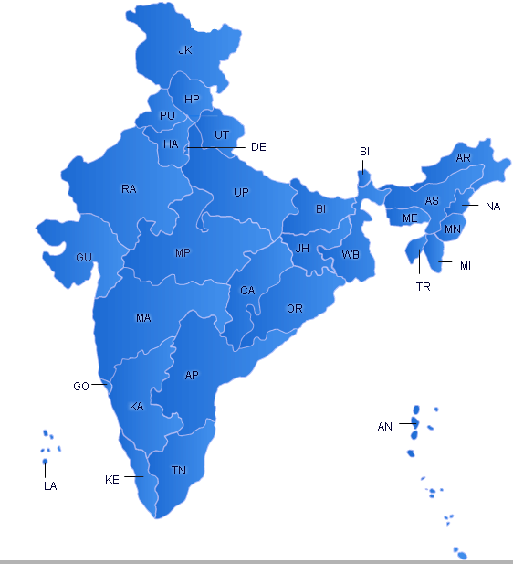
Motivation & Applications
We want to paint the states with yellow color as we hover the mouse over them in a software application.
We have the subdivision i.e. the boundaries of the states.
We know the coordinates of mouse pointer.
Solution: Point Location.
Prepared by Nilanjan Basu

Slide 5
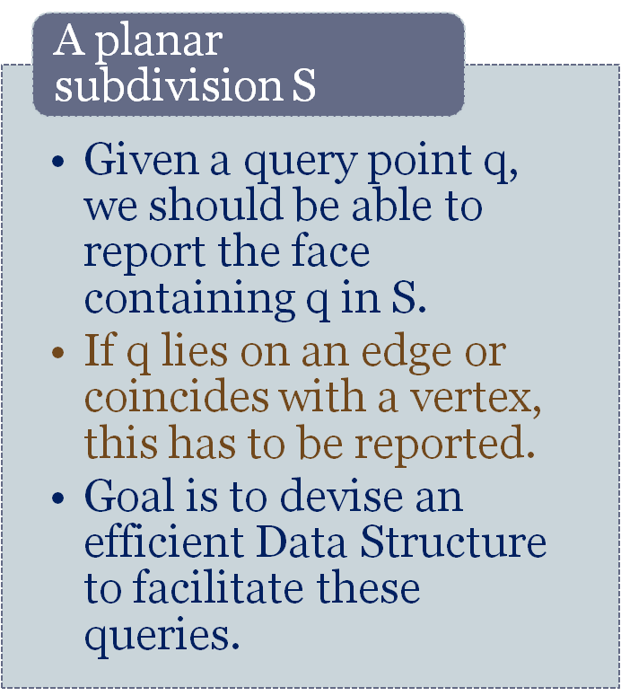
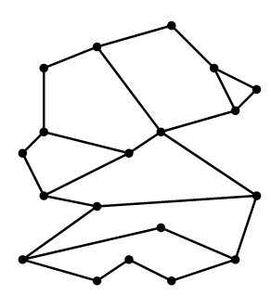
What Do We Have in Our Hand?
Prepared by Nilanjan Basu

Slide 6
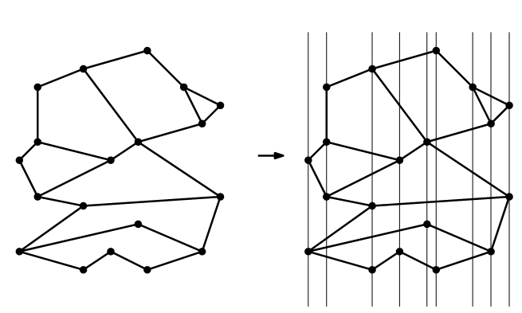
Approach #1: Partitioning into Slabs
Prepared by Nilanjan Basu

Slide 7
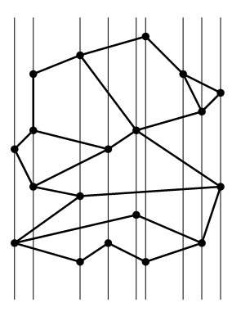
Approach #1: Partitioning into Slabs
We draw vertical lines through the vertices – partition the plane into vertical slabs.
Store the x-coordinates in an array in sorted order.
Now, we can query the point and locate the slab containing it in O(log n).
Prepared by Nilanjan Basu

Slide 8

Approach #1: Partitioning into Slabs
Inside a slab, there is no vertex.
This imposes a special property:
    Intersecting edged cross a slab completely.
    They do not have endpoints in the slab.
    They do not cross each other.
So, they can be ordered from top to bottom, hence eligible for binary search.
every region in the slab between two consecutive edges belongs to a unique face of S.
Prepared by Nilanjan Basu

Slide 9
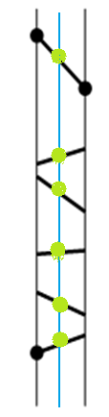
Approach #1: Partitioning into Slabs
Label each edge with the face just above it.
Query is:
      Given a segment s and a point q such that the vertical line through q intersects s, determine whether q lies above s, below s or on s.
So, the time efficiency of this algorithm is good.
It only takes O(n log n) time for building the Data Structure.
Subsequent queries take O(log n) time.
Prepared by Nilanjan Basu
Notes:
O(n logn) taking account of sorting.

Slide 10
Approach #1: Partitioning into Slabs
Alas! The amount of storage required for this Data Structure is high.
We have an array of x-coordinates[O(n) storage].
For each slab we have an array of edges that intersect the slab.[O(n) storage]. (Questions?).
So, in the worst case we may have O(n^2) storage. ☹
One may argue that it is highly unusual but still we can frequently see O(n^3/2) storage requirements (This is based on complex analysis-out of scope).
Prepared by Nilanjan Basu

Slide 11
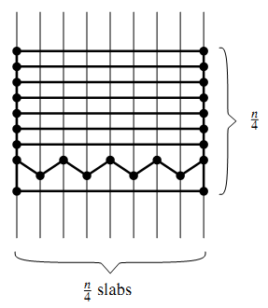
Approach #1: Partitioning into Slabs
Let us take an example to see for ourselves:
Prepared by Nilanjan Basu
Notes:
Closer look:
Where does this quadratic behavior come from? Let’s have a second look at Figure. The segments and the vertical lines through the endpoints deﬁne a new subdivision S, whose faces are trapezoids, triangles, and unbounded trapezoid-like faces. Furthermore, S is a reﬁnement of the original subdivision S: every face of S lies completely in one face of S. The query algorithm described above is in fact an algorithm to do planar point location in this reﬁned subdivision. This solves the original planar point location as well: because S is a reﬁnement of S, once we know the face f ∈ S containing q,we know the face f ∈ S containing q. Unfortunately, the reﬁned subdivision can have quadratic complexity. It is therefore not surprising that the resulting data structure has quadratic size.
Perhaps we should look for a different reﬁnement of S that—like the decomposition shown above—makes point location queries easier, and that—unlike
the decomposition shown above—has a complexity that is not much larger than the complexity of the original subdivision S. Indeed such a reﬁnement exists.In the rest of this section, we shall describe the trapezoidal map, a reﬁnement that has the desirable properties just mentioned.

Slide 12
Approach #2: Trapezoidal Maps-Motivation
Previous approach used too much splitting.
Reduce the splitting to obtain a refinement of lesser complexity.
Need to have a refinement that has less than quadratic complexity.
This refinement is called Trapezoidal Map.
We assume the following to make things easier:
    X-coordinates are not same for any two vertex.
    No open face- add a bounding box R containing all segments S.
Prepared by Nilanjan Basu

Slide 13
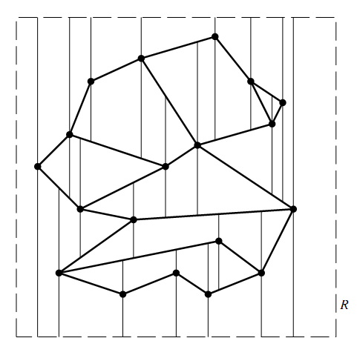
Trapezoidal Maps: Example
Some terms:
  Set of line segments in General Positions.
  Vertical Extensions
  Trapezoidal Decomposition/Vertical Decomposition.
Prepared by Nilanjan Basu
Notes:
So we have a set S of n non-crossing line segments, enclosed in a bounding box R, and with the property that no two distinct endpoints lie on a common vertical line. We call such a set a set of line segments in general position. The trapezoidal map T(S) of S—also known as the vertical decomposition or trapezoidal decomposition of S—is obtained by drawing two vertical extensions from every endpoint p of a segment in S, one extension going upwards and one going downwards. The extensions stop when they meet another segment of S or the boundary of R. We call the two vertical extensions starting in an endpoint p the upper vertical extension and the lower vertical extension. The trapezoidal map of S is simply the subdivision induced by S, the rectangle R, and the upper and lower vertical extensions.

Slide 14
Trapezoidal Map: Is it really Trapezoidal?
Lemma:
Each face in a trapezoidal map of a set S of line segments in general position has one or two vertical sides and exactly two non-vertical sides.
Proof:
  A face F is convex in T(S)
    Because of vertical extensions no corner can be > 180 degree.
    For R, corner is = 90 degree.
  Convexity => At most 2 vertical sides.
  If it has more than two non vertical sides…
Prepared by Nilanjan Basu

Slide 15
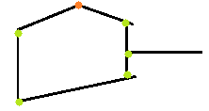
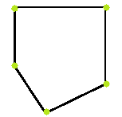
Trapezoidal Map: Is it really Trapezoidal?
This is not possible. So, F does not have more than 2 non-vertical edges.
Can F have less than 2 edges?
  F is bounded , so it must have at least 2 edges.
So, the lemma is proved. It indeed is trapezoidal.
Triangles are also possible, but they are degenerate trapeziums.
Prepared by Nilanjan Basu
Notes:
Because any non-vertical side must be contained in a segment of S or in an edge of R, and the segments are non-crossing, the two adjacent sides must meet in a segment endpoint. But then the vertical extensions for that endpoint prevent the two sides from being adjacent, a contradiction. Hence, f has at most two non-vertical sides.

Slide 16
Improvement in Refinement
We have indeed reduced the number of subdivisions from O(n^2) to O(n). How?
Lemma:
The trapezoidal map T(S) of a set S of n line segments in general position contains at most 6n+4 vertices and at most 3n+1 trapezoids.
Here, number of subdivisions = O(3n+1) = O(n).
So, our data structure based on Trapezoidal Maps should only need O(n) space.
Prepared by Nilanjan Basu
Notes:
6n+4 = 4+ 2n+ 2(2n)
For n segments, rightp(delta) = 1 -> for n -> n
,, ,, ,, leftp(delta) = 2-> for n->2n

Slide 17
How to Answer the Query
We build a decision tree-
  Only two child per internal node.
  Leaves: Individual Trapezoids.
  Internal Nodes:
    X-nodes: Labeled with end-point of a segment
    Y-Nodes: Labeled with a segment itself.
  While traversing the tree, perform queries to select child:
    X-node query: Does q lie to the right or left to this point?
    Y-node query: Does q lie to above or below this line segment?
  Start from root and go down to the leaf node to find the appropriate trapezoid.
Prepared by Nilanjan Basu

Slide 18
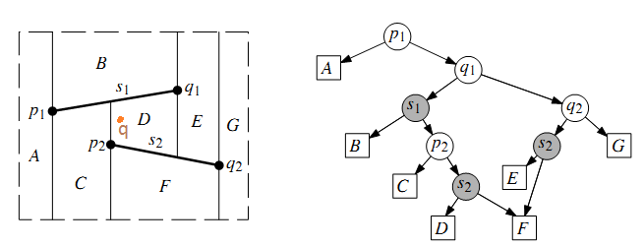
Decision Tree: Example
Prepared by Nilanjan Basu

Slide 19
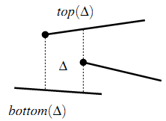
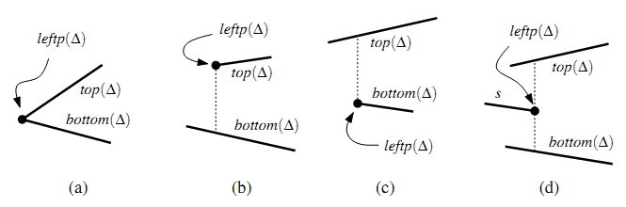
Some Useful Notations
top(∆):= non vertical segment of S or edge of R, bounding trapezoid ∆ from above.
bottom(∆):=non-vertical segment of S or edge of R, bounding ∆ from below.
leftp(∆):=
Prepared by Nilanjan Basu
Notes:
Include R as necessary.

Slide 20
Some Useful Notations
Note that there is another case:
  For the unique trapezoid whose left side is the left edge of R, denote leftp(∆) := lower left vertex of R.
rightp(∆):= Define similarly as leftp(∆).
Note: ∆ is uniquely determined by top(∆), bottom(∆), rightp(∆),leftp(∆).
Prepared by Nilanjan Basu

Slide 21
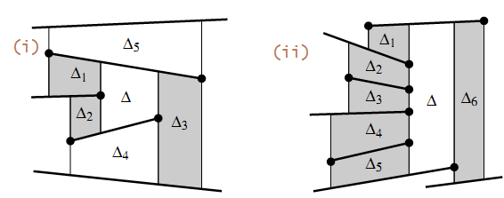
Few More Useful Notations
Two trapezoids are adjacent if they meet along a vertical edge.
When the set is not in a General Position, arbitrary no. of adjacent ∆s are possible.
Prepared by Nilanjan Basu
Notes:
In figure (i)-> Del 1 and Del 2 are adjacent but Del 4 and Del 5 are not.

Slide 22
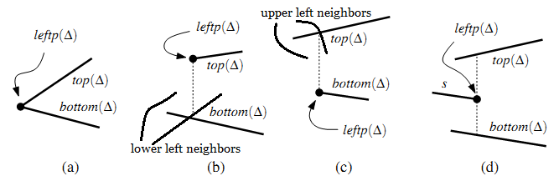
Useful Notations Continues
Upper Left Neighbor / Lower Left Neighbor:
Upper Right Neighbor / Lower Right Neighbor:
  Define accordingly.
Prepared by Nilanjan Basu

Slide 23
Decision Tree Construction
Algorithm:
  Input: A set S of n non-crossing line segments.
  Output: The trapezoidal map T(S) and a search structure D for T(S) in a bounding box.
  1. Determine the bounding-box R, initialize Trapezoidal-Map T and
  Decision Tree D.
  2. Compute a random permutation s1,s2,…,sn, of the elements of S.
  3. For each segment si,
  a) find the set ∆0,∆1,...,∆k of trapezoids in T properly intersected
  by si.
  b) Remove them from T and replace them by the new
  trapezoids that appear because of the insertion of si
  c) Remove the leaves of D for the old trapezoids and
  create leaves for the new ones and update links
Prepared by Nilanjan Basu
Notes:
Basically we add one edge at a time and deduce the effect.

Slide 24
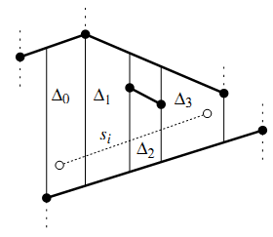
DT Construction: Finding intersected ∆s
How to find the trapezoids intersected by current segment?
  Find the ∆s containing the end point of current segment by querying the already built Decision Tree.
  From the leftmost ∆ containing start of segment, proceed rightward adding appropriate ∆s upto end of the segment.
  Note that ∆i and ∆(i+1) are neighbors.
  If rightp(∆i) lies above segment s, then ∆(i+1) = lower right neighbor (∆), else ∆(i+1) = upper right neighbor(∆).
Prepared by Nilanjan Basu

Slide 25
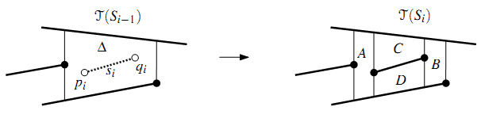
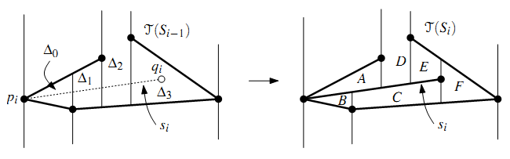
Updating T
When Si is contained in a ∆
Si intersects 2 or more ∆s
Prepared by Nilanjan Basu

Slide 26
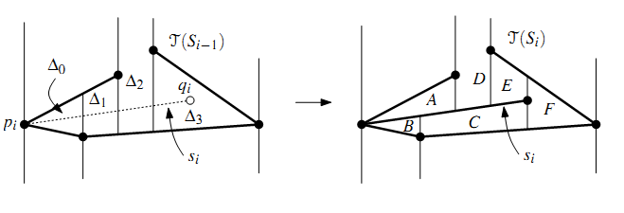
More detail on 2 or more intersection case
First erect vertical extensions through the endpoints of Si, partitioning ∆0 and ∆k into 3 ∆s each.
Shorten the vertical extensions to merge ∆s along Si
This step can be done in O(k) i.e. linear time.
Prepared by Nilanjan Basu

Slide 27
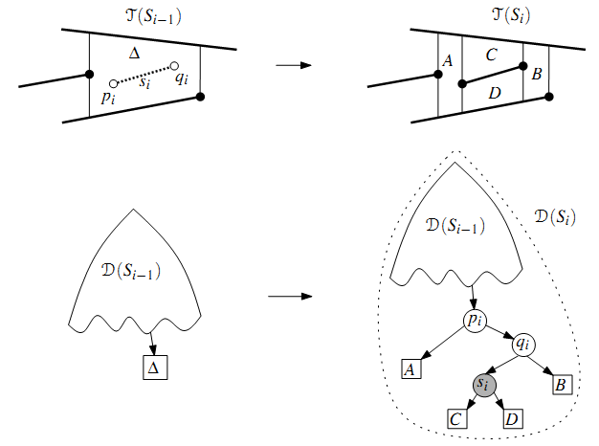
Updating D: Simple Case
Prepared by Nilanjan Basu
Notes:
Corner Case: when pi or qi coincides with leftp(Delta) or rightp(delta).

Slide 28
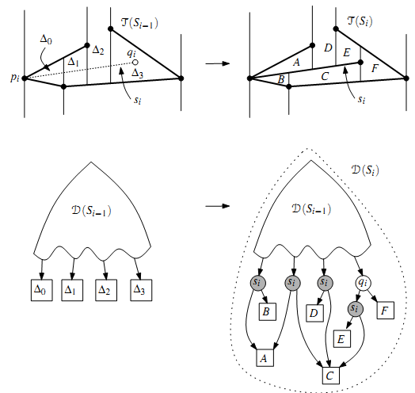
Updating D: Complex Case
Must remove nodes for ∆0, ∆1,…, ∆k.
Must create new nodes for new ∆s and introduce extra inner nodes.
If ∆0 has the left endpoint p of Si in its interior, replace the leaf for ∆0 with a point node for p and a segment node for Si (similarly with ∆k).
Replace the leaves of the other trapezoids with single segment nodes for Si.
Make the outgoing edges of the inner nodes point to the correct leaves
Prepared by Nilanjan Basu
Notes:
Here no x-node for pi as there is no Delta at the left of pi. It will be incorrect to include it.

Slide 29
Analysis of Trapezoidal Map Method
We are more interested in expected complexity than actual worst case complexity.
This method is also called “Randomized Incremental Algorithm”. Randomness exposes the true nature.
Analysis:
  Running Time: O(nlog n).
  Storgae requirement: O(n).
  Query time for a fixed point q: O(log n).
Prepared by Nilanjan Basu

Slide 30
Analysis of Query Time
Fix a query point q, and consider the path in D traversed by the query.
Define
– Si= {s1, s2, ..., si}
– Xi= number of nodes added to the search path for
q during iteration i.
– Pi= probability that some node on the search path
of q is created in iteration i.
– ∆q(Si) = trapezoid containing q in T(Si)
From our construction, Xi <= 3; thus E[Xi]<= 3Pi.
Note that, Pi = Pr[∆q(Si) != ∆q(Si−1)].
Prepared by Nilanjan Basu
Notes:
-query time for q is linear in the length of the path in D that is traversed when querying with q. So, we bound the path in D.
-Path length increases by 3n in each iteration of the algorithm. So, it is the worst case upper bound, but we are not inerested.
-iteration i contributes a node to the search path of q exactly if ∆q(Si−1), the trapezoid containing q in T(Si−1), is not the same as ∆q(Si), the trapezoid containing q in T(Si).

Slide 31
Analysis of Query Time
What is Pr[∆q(Si) != ∆q(Si−1)]?
  Backward analysis: How many segments in Si affect ∆q(Si) when they are removed?*
    At most 4
Since they have been chosen in random order, each one has probability 1/i of being si.
Thus Pi <= 4/I
E[ ∑i Xi] = ∑i . E [ Xi] <= ∑i 3.Pi <= ∑i. ∑ 12/i = O(log n)
Prepared by Nilanjan Basu

Slide 32
Analysis of Storage Requirements
Number of nodes bounded by O(n) + ∑i ki, where ki= number of new trapezoids created in iteration i.
Define d(∆,s) to be 1 iff ∆ disappears from T(Si) when s removed from Si.
So,
Prepared by Nilanjan Basu

Slide 33

Total Running Time
We only need to observe that the time to insert segment si is O(k_{i}) plus the time needed to locate the left endpoint of s_{i} in T(S_{i}−1).
Total runtime:
Prepared by Nilanjan Basu

Slide 34
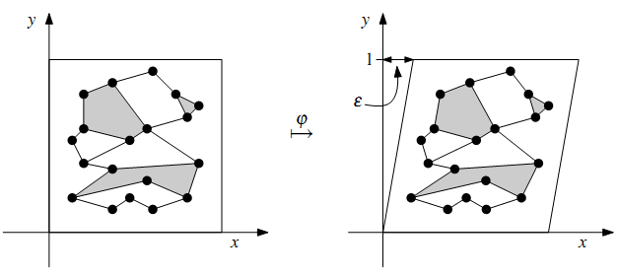

Resolve Degenerate Cases
    When X-coordinates are same for 2 vertices:
    This is called Shear Transformation.
Prepared by Nilanjan Basu
Notes:
We could also have performed rotation but this could lead to numerical difficulties depending on precision of arithmetic operations.

